Slide 1
Linear Algebra
线性代数
Zongbin Chen YMSC, Tsinghua University
陈宗彬 清华大学数学科学中心
Email: zbchen@tsinghua.edu.can

Slide 2

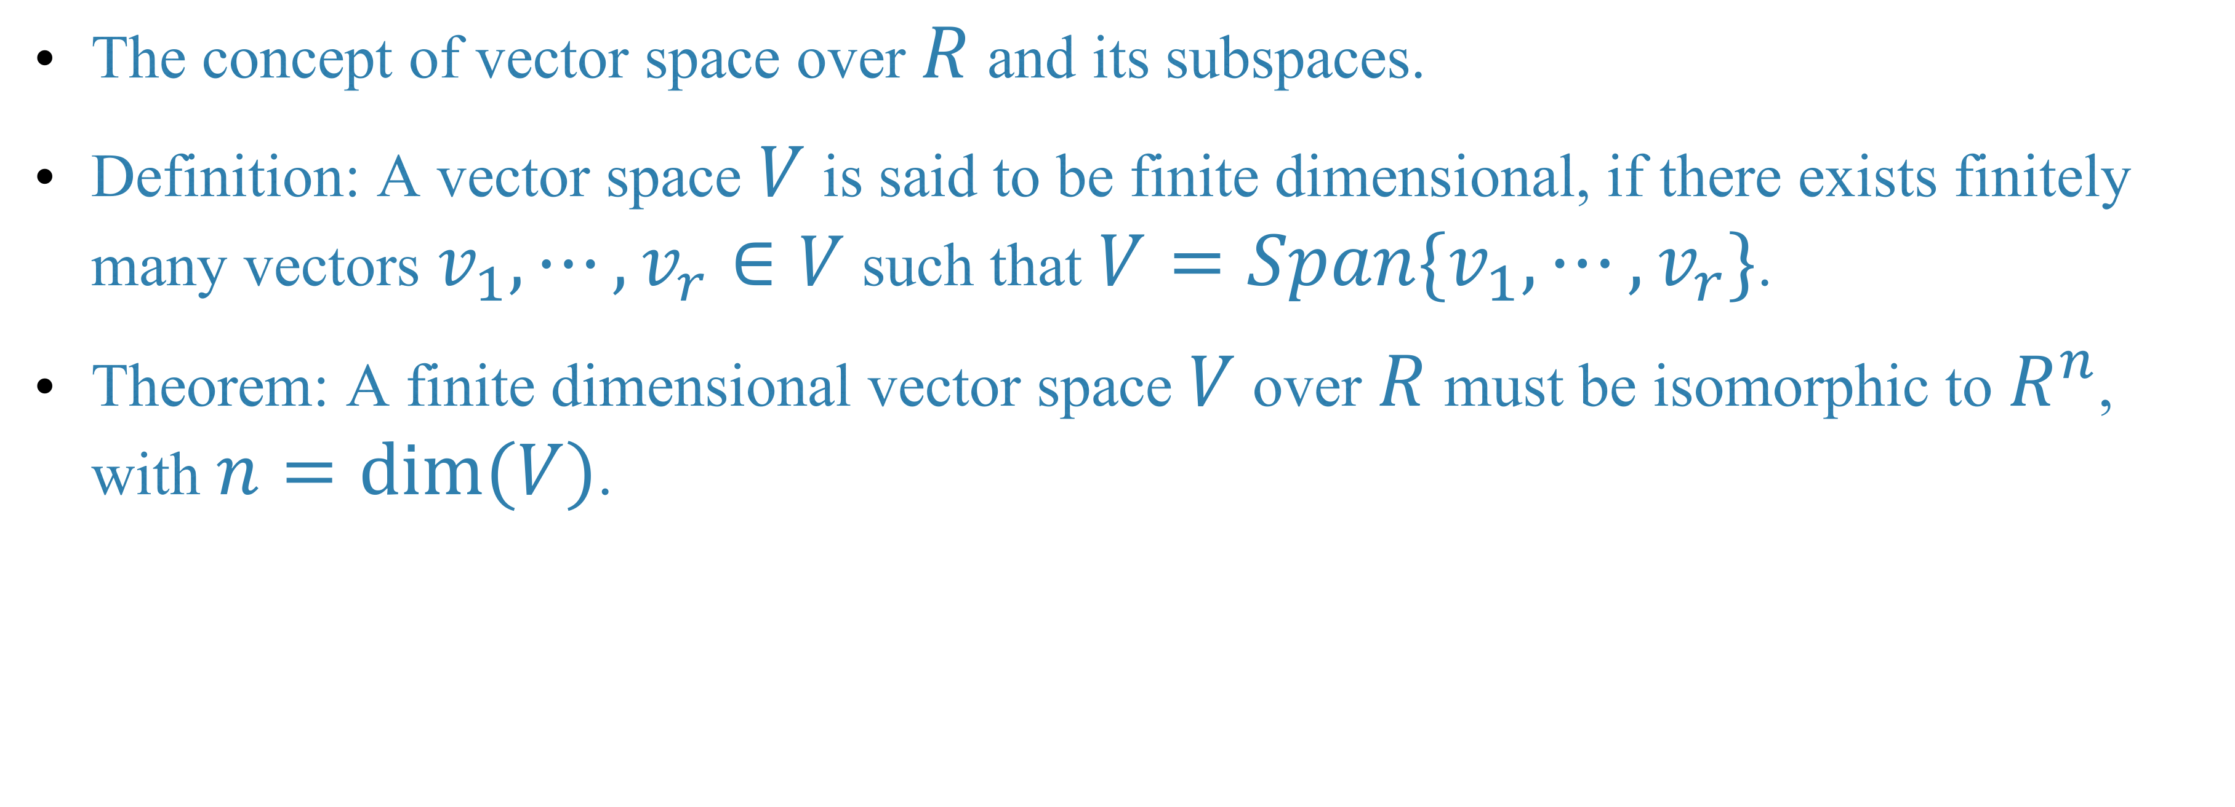

Quick review
Finite dimensional vector space
The concept of vector space over $R$ and its subspaces.
Definition: A vector space $V$ is said to be finite dimensional, if there exists finitely many vectors $v_{1},⋯,v_{r}∈V$ such that $V=Span\{v_{1},⋯,v_{r}\}$.
Theorem: A finite dimensional vector space $V$ over $R$ must be isomorphic to $R^{n}$, with $n=dim(V)$.

Slide 3
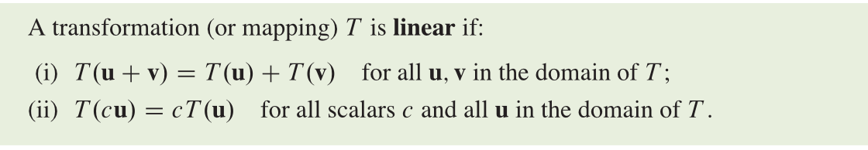

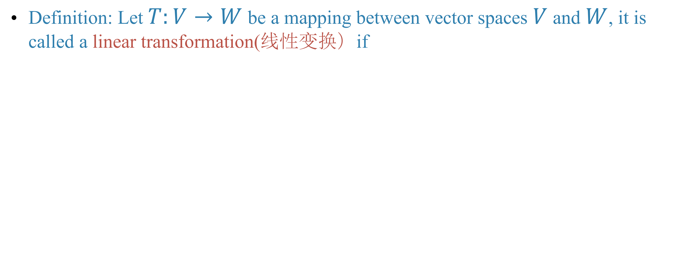
Linear transformation
Definition: Let $T:V→W$ be a mapping between vector spaces $V$ and $W$, it is called a linear transformation(线性变换）if

Slide 4
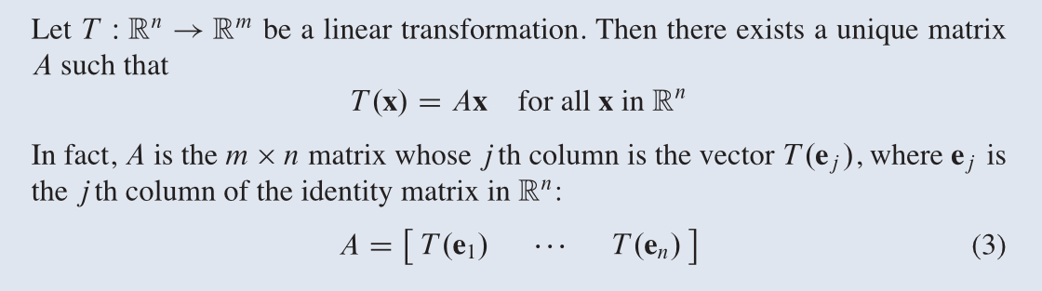
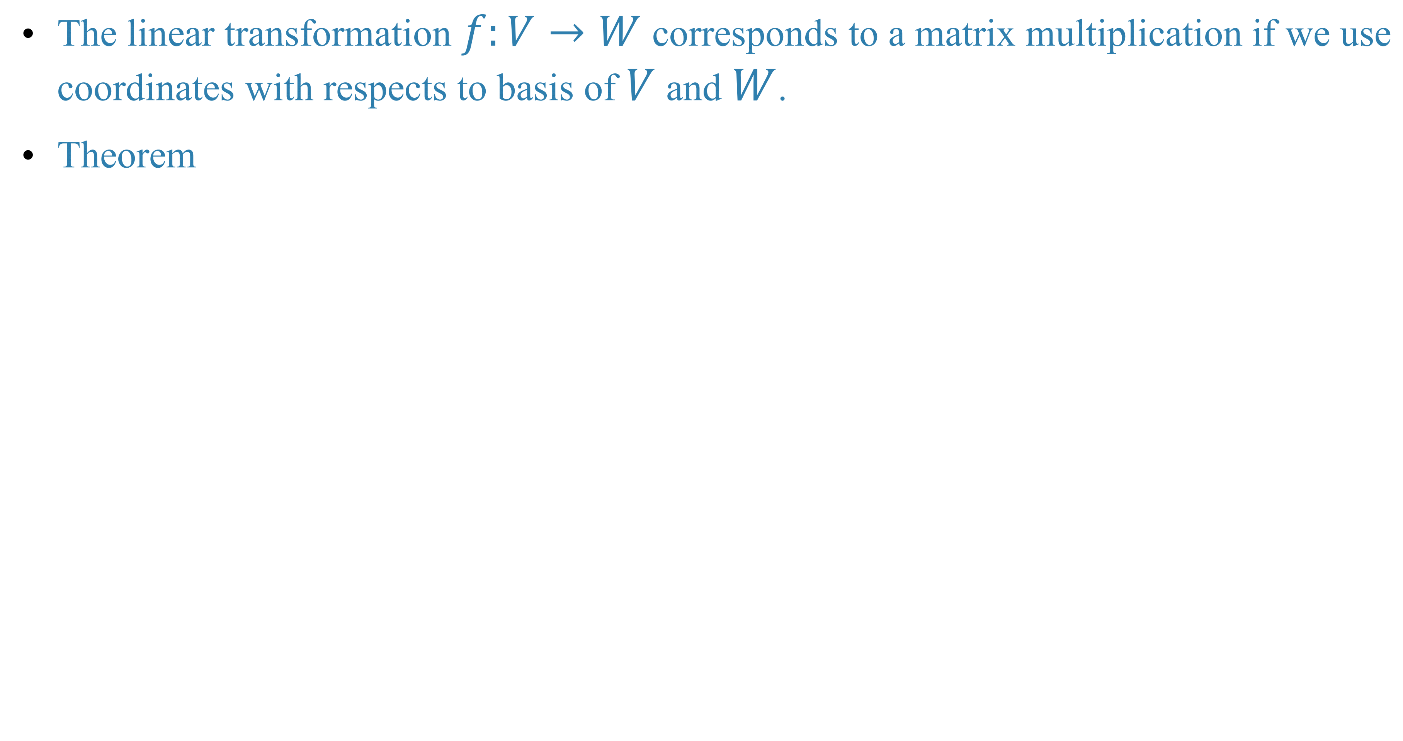
The linear transformation $f:V→W$ corresponds to a matrix multiplication if we use coordinates with respects to basis of $V$ and $W$.
Theorem

Slide 5
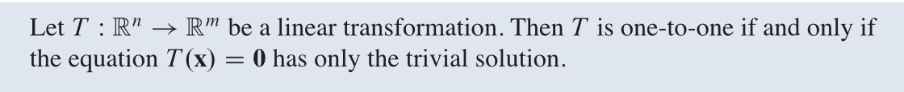
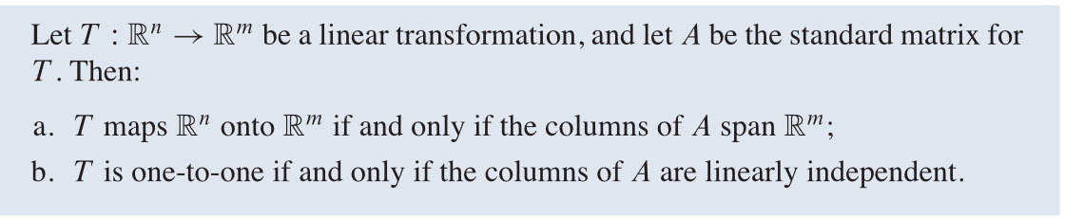
Theorem
Theorem

Slide 6

Sum and scalar multiples of a matrix

Slide 8
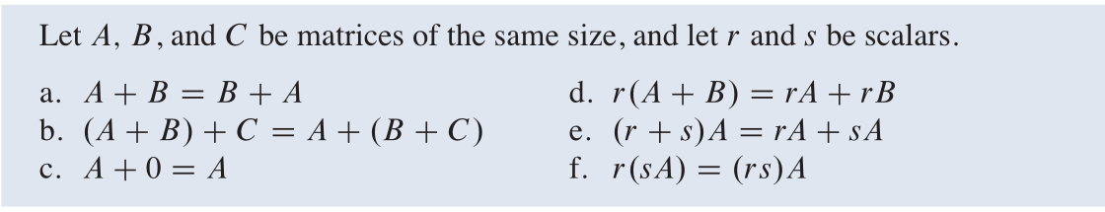
Theorem

Slide 9
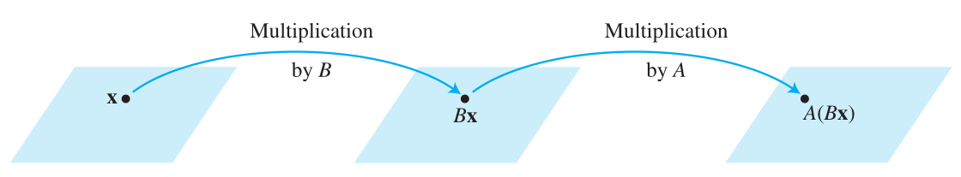
Composition of linear transformation and matrix multiplication

Slide 12
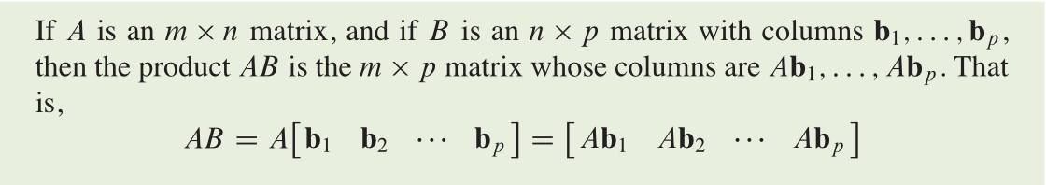
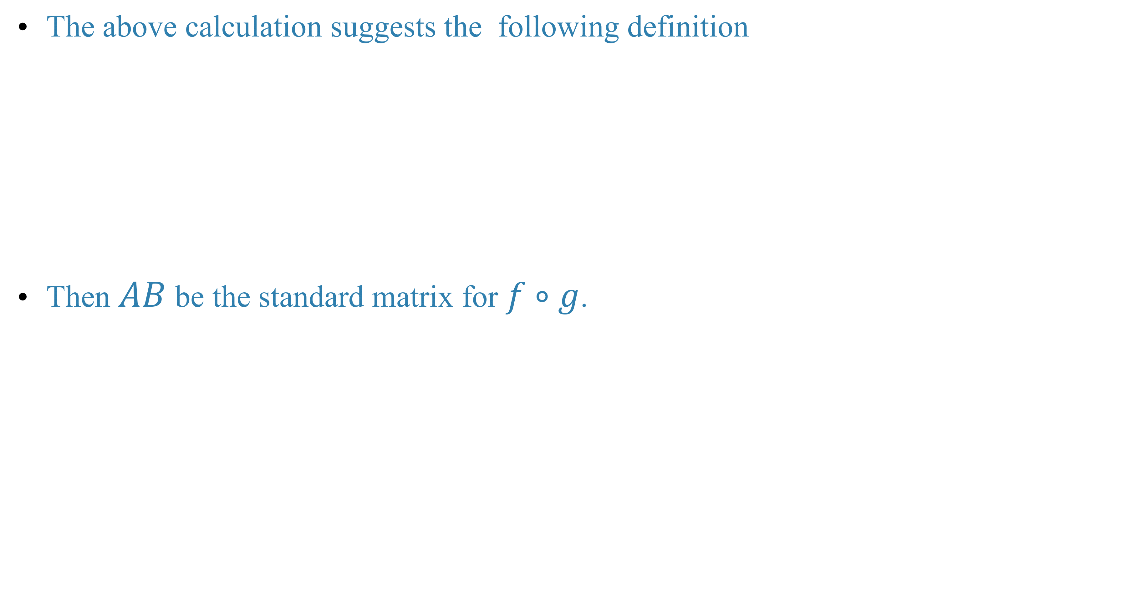
The above calculation suggests the following definition
Then $AB$ be the standard matrix for $f∘g$.

Slide 13
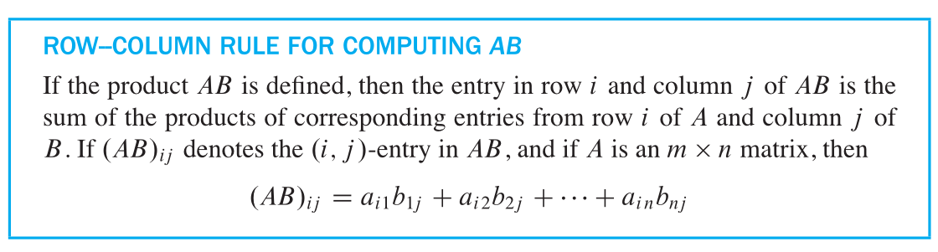
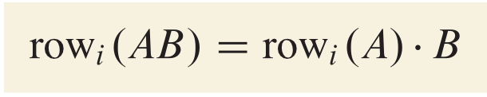
Notice also that

Slide 14
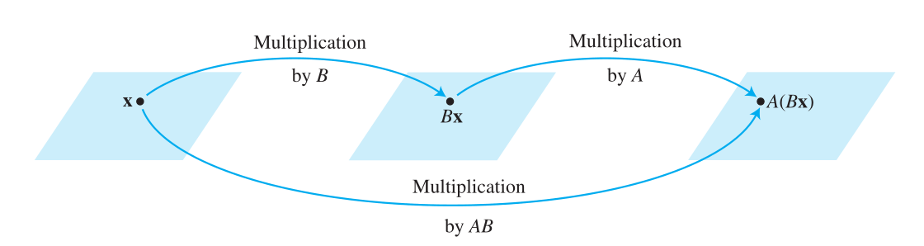
Summary

Slide 15
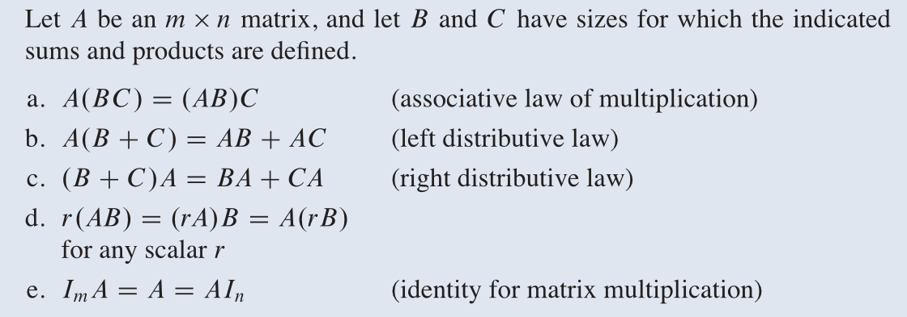
Properties of matrix multiplication

Slide 16
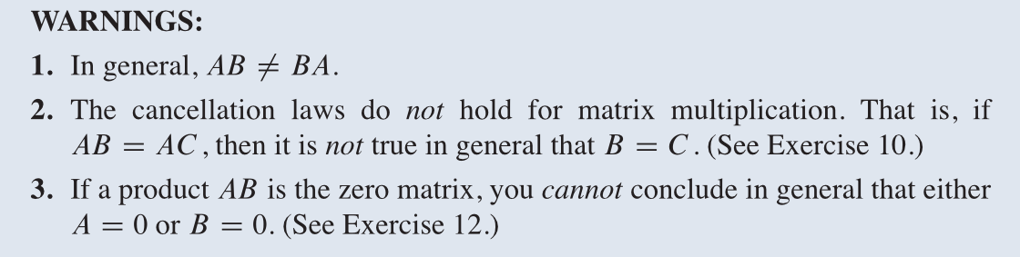

Slide 17
Transposition(转置) of a matrix

Slide 18
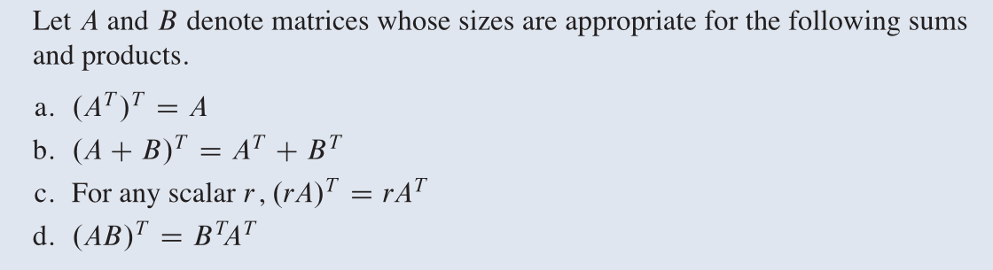

Slide 19
The inverse of a matrix
Invertible linear transformation (可逆线性变换)

Slide 21
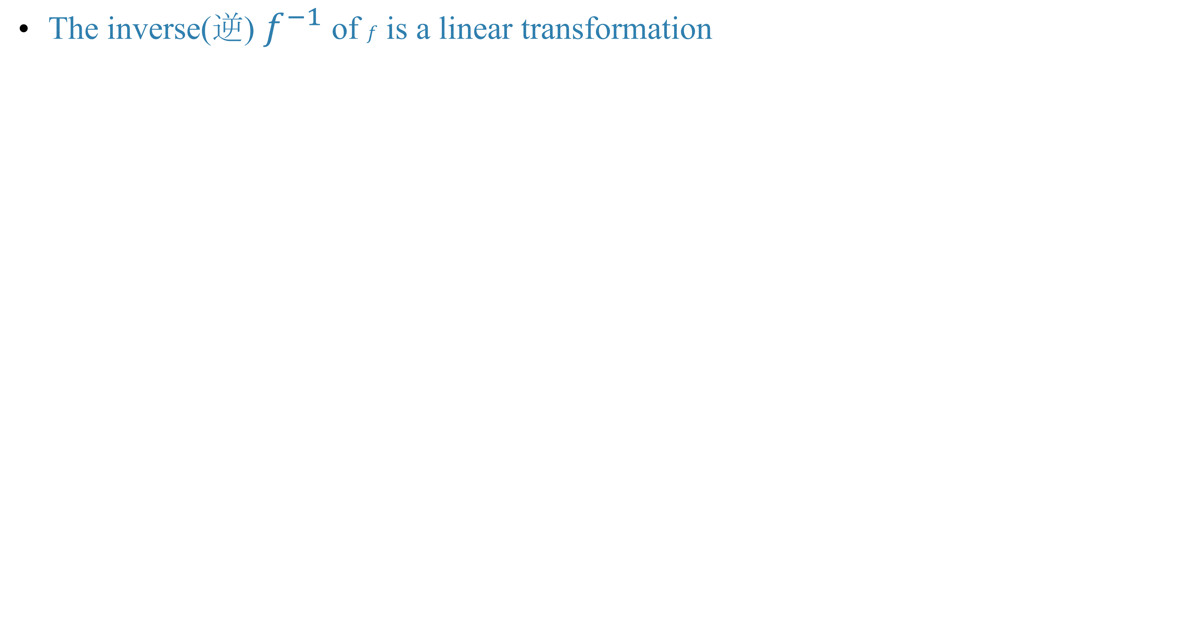
The inverse(逆) $f^{−1}$ of $f$ is a linear transformation

Slide 22
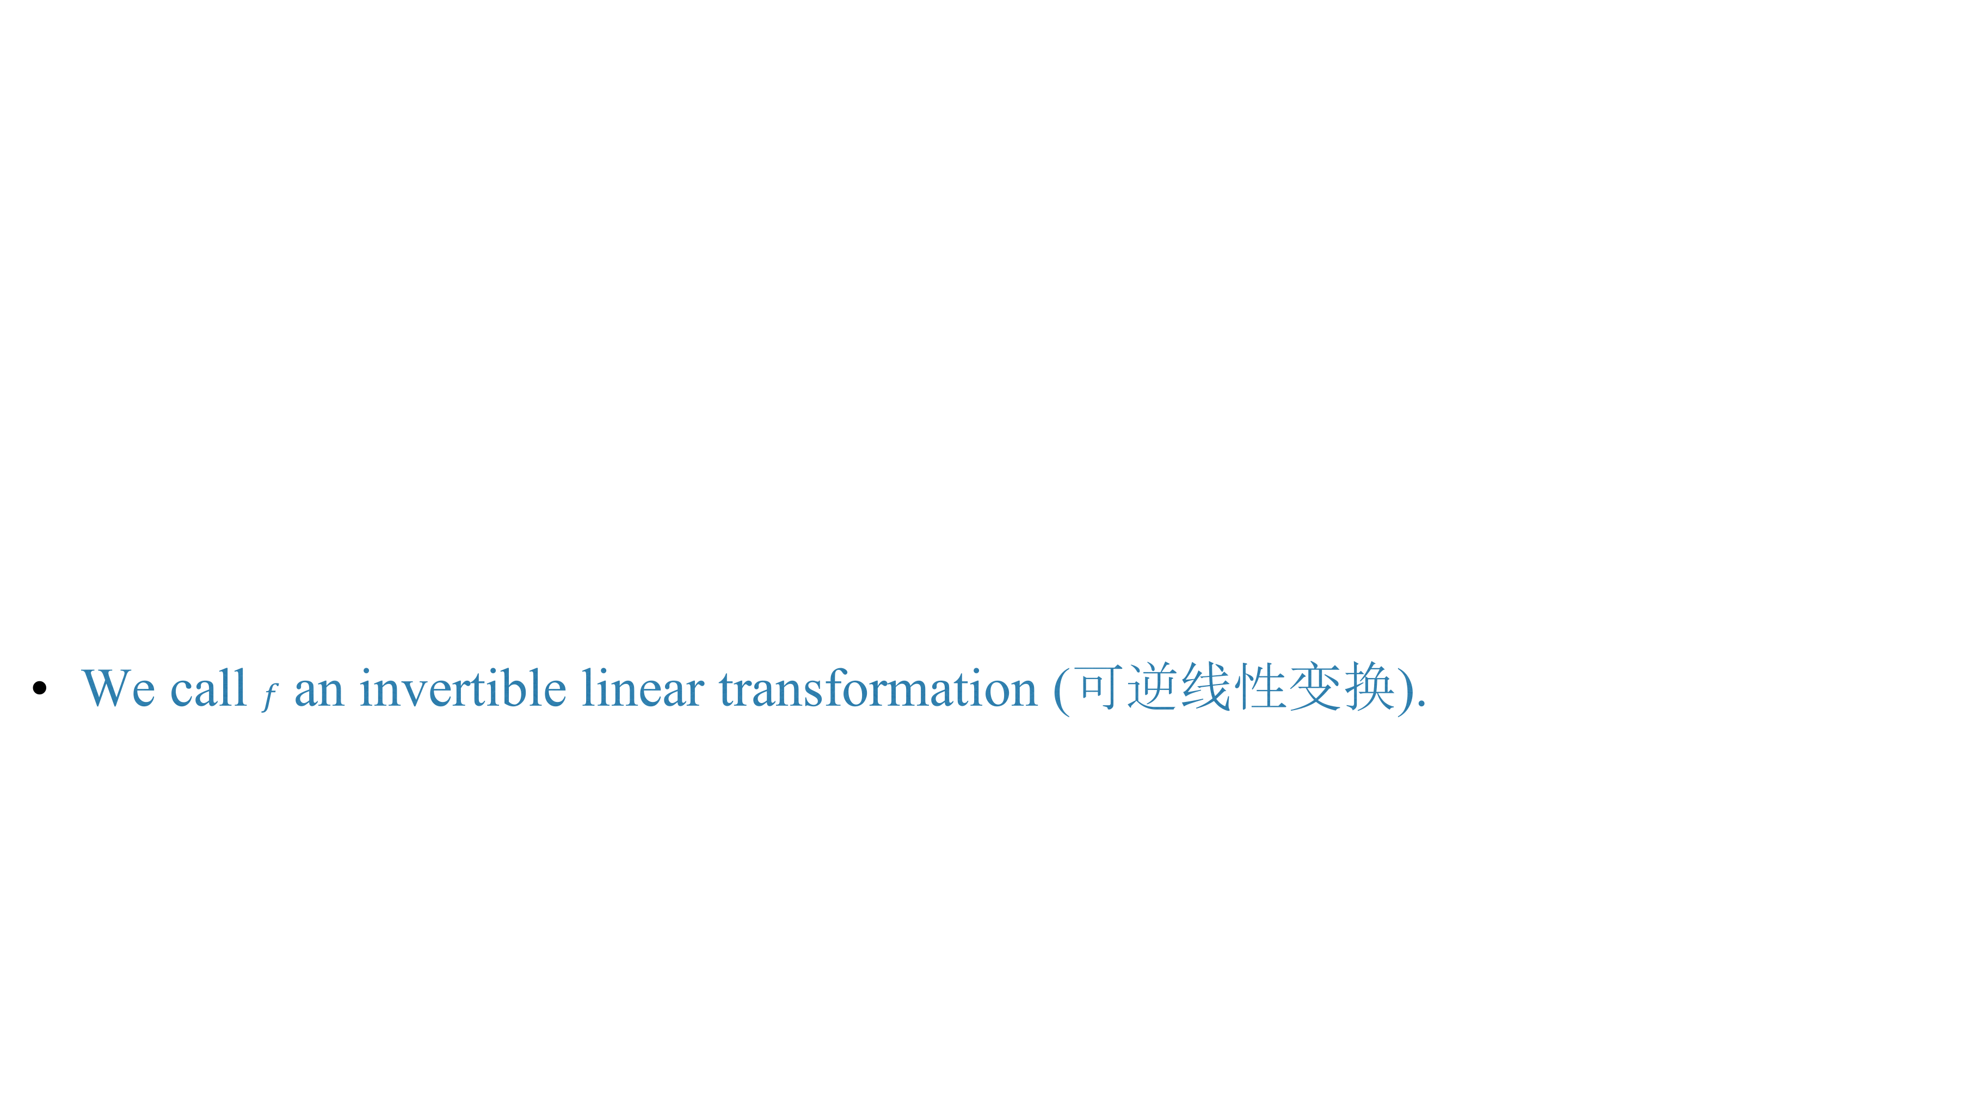
We call $f$ an invertible linear transformation (可逆线性变换).

Slide 23
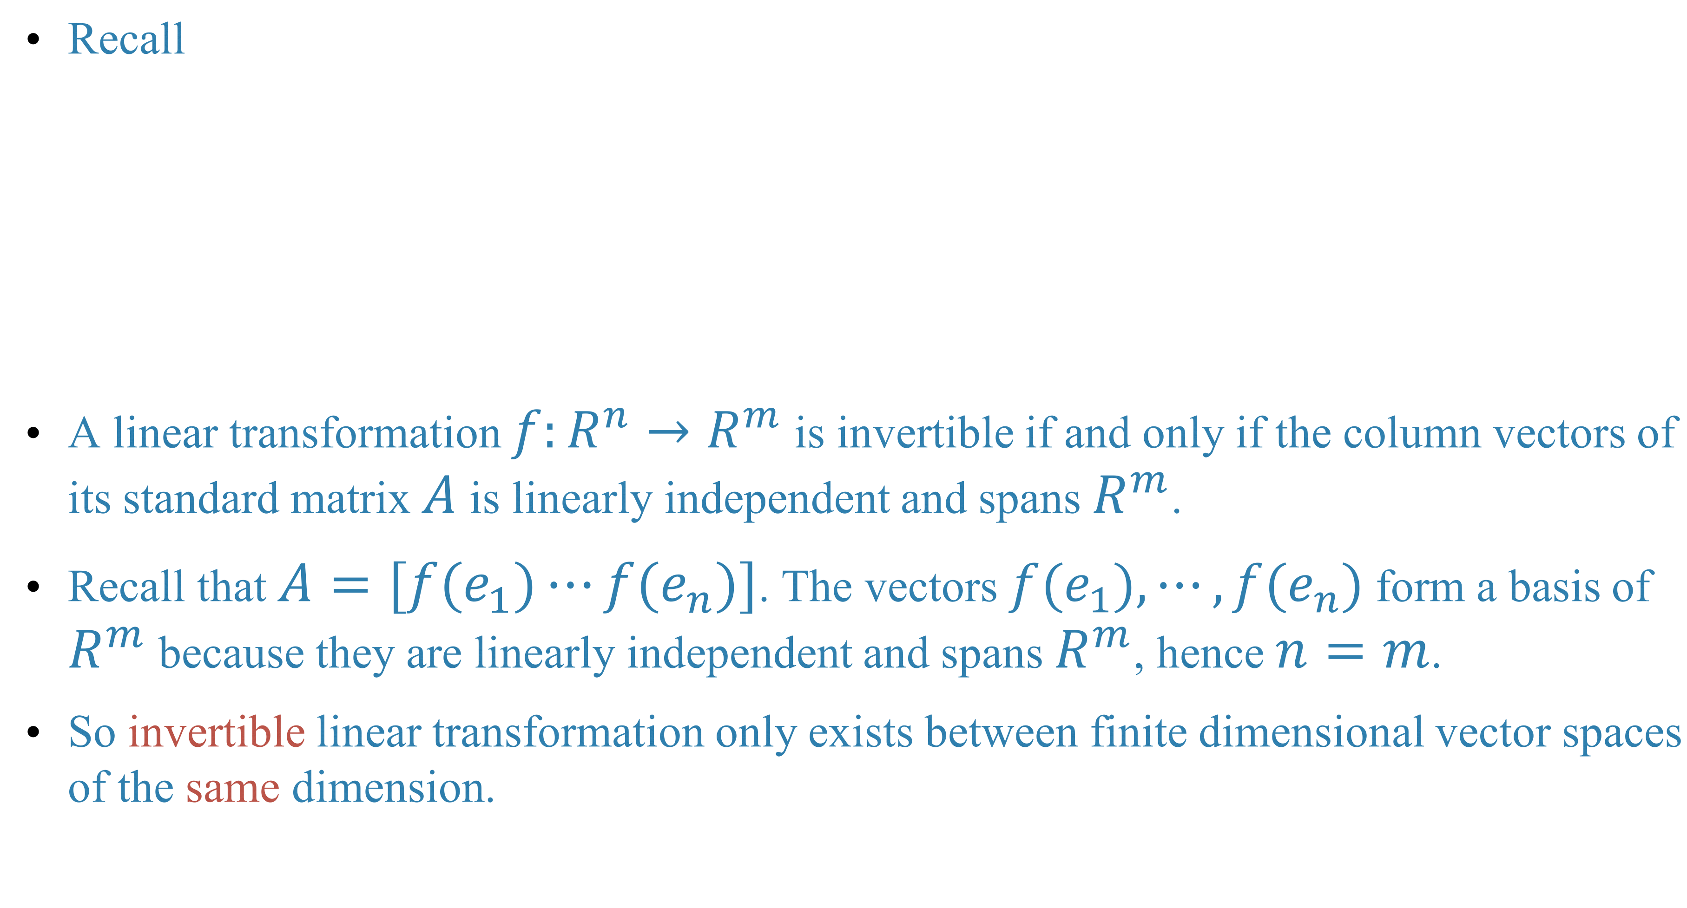
Recall
A linear transformation $f:R^{n}→R^{m}$ is invertible if and only if the column vectors of its standard matrix $A$ is linearly independent and spans $R^{m}$.
Recall that $A=[f(e_{1})⋯f(e_{n})]$. The vectors $f(e_{1}),⋯,f(e_{n})$ form a basis of $R^{m}$ because they are linearly independent and spans $R^{m}$, hence $n=m$.
So invertible linear transformation only exists between finite dimensional vector spaces of the same dimension.

Slide 24
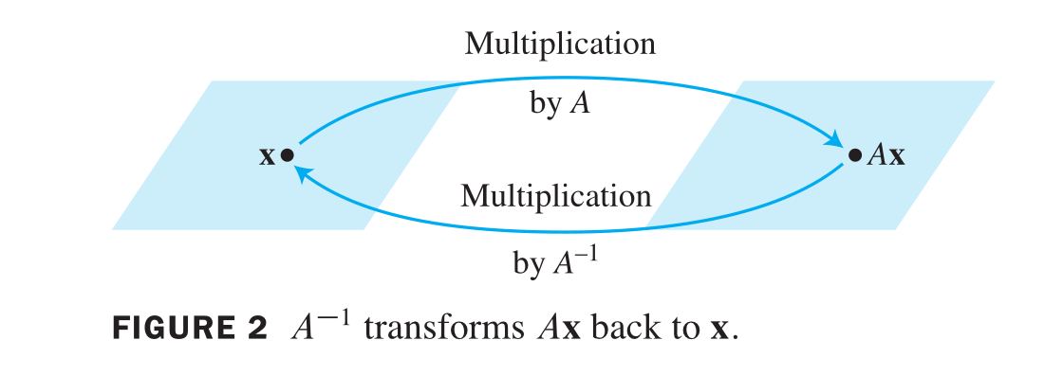
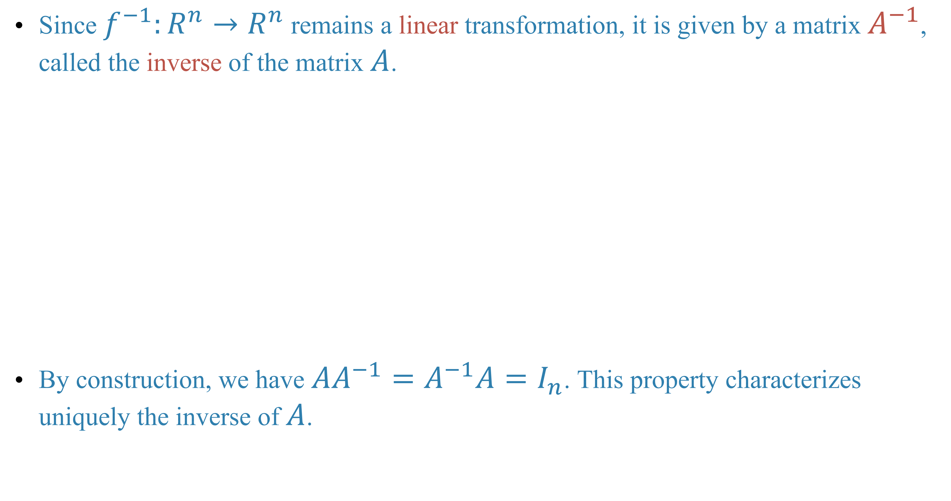
Since $f^{−1}:R^{n}→R^{n}$ remains a linear transformation, it is given by a matrix $A^{−1}$, called the inverse of the matrix $A$.
By construction, we have $AA^{−1}=A^{−1}A=I_{n}$. This property characterizes uniquely the inverse of $A$.

Slide 25
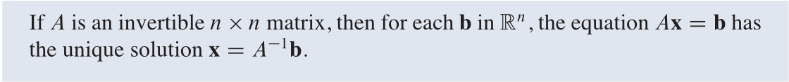
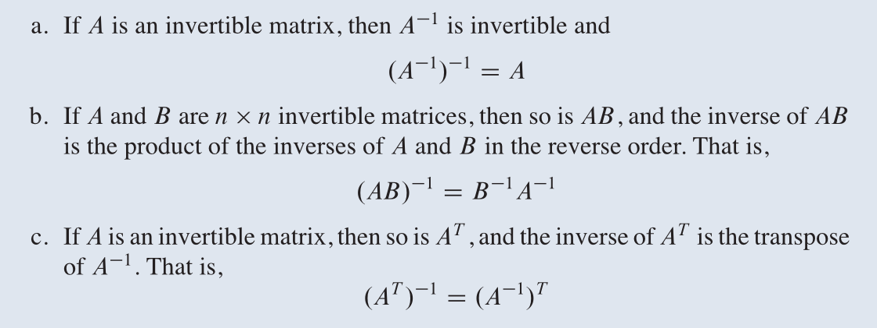
The above discussion also implies the theorem:
Basic properties

Slide 28
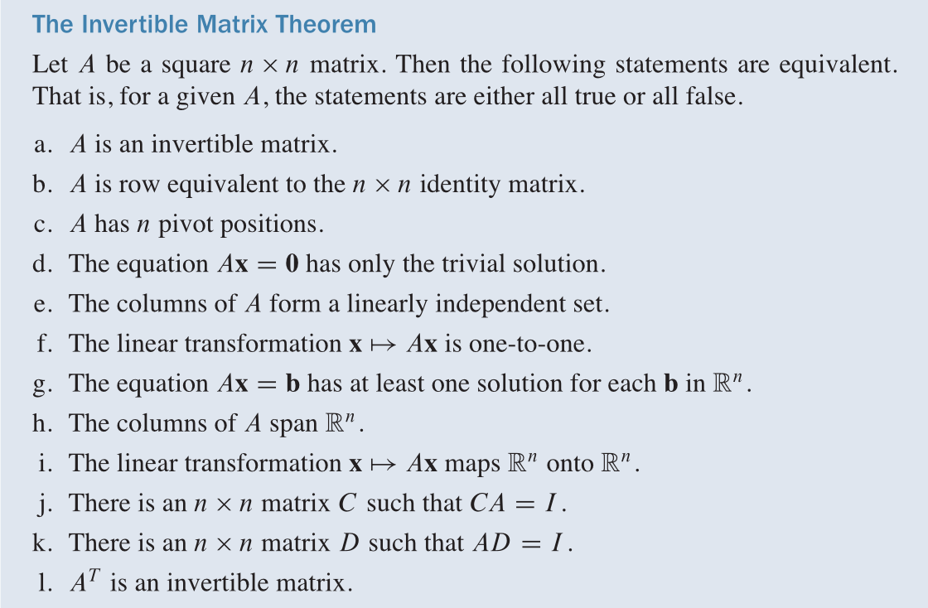
Criteria for being invertible

Slide 29
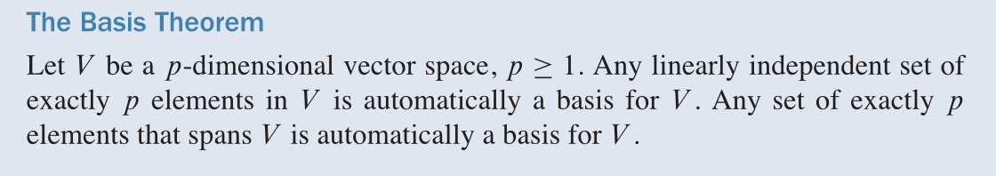

Slide 30
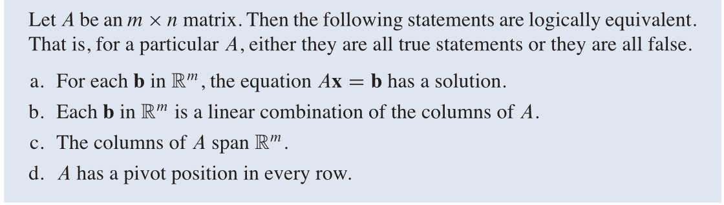

Slide 33
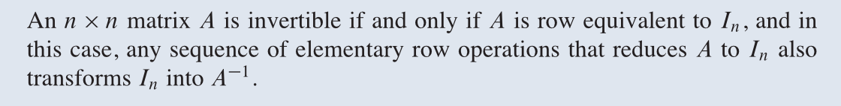
How to calculate the inverse of a matrix
Theorem

Slide 36
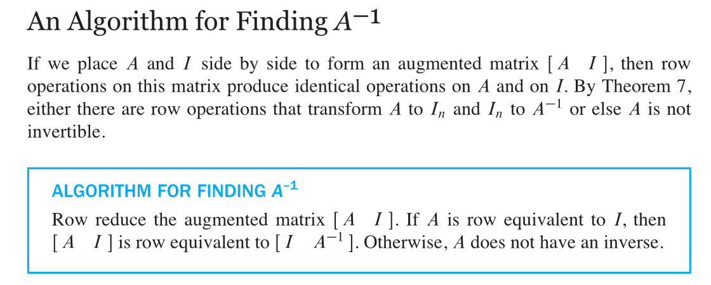

Slide 37

Example

Slide 39
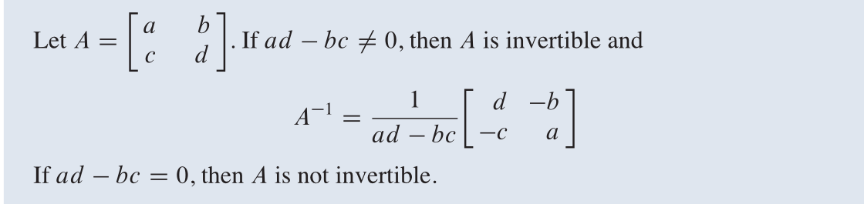
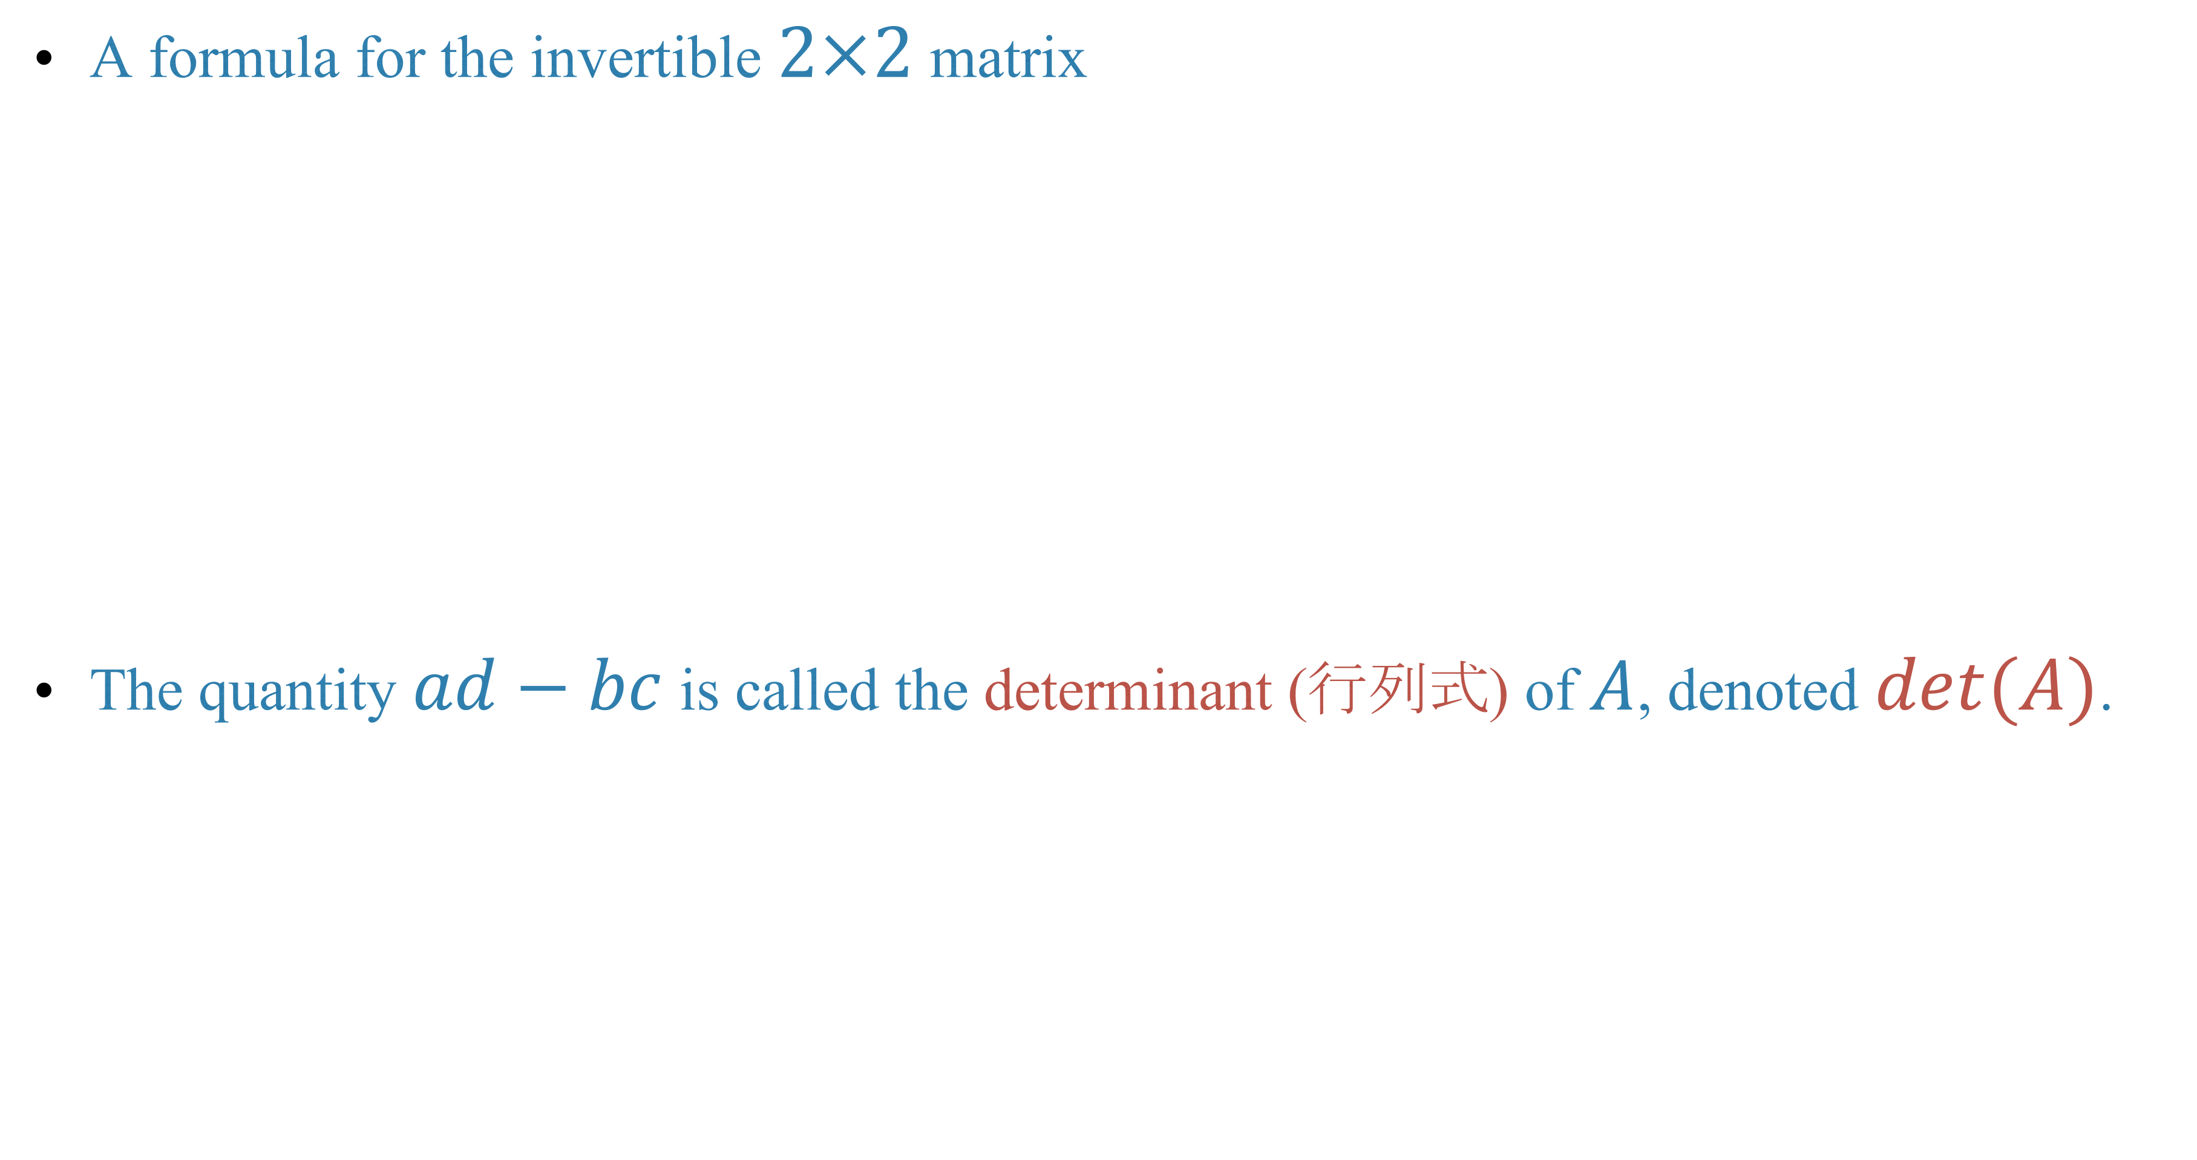
A formula for the invertible $2×2$ matrix
The quantity $ad−bc$ is called the determinant (行列式) of $A$, denoted $det(A)$.

Slide 41
Homework
Lay-Lay-McDonald, chapter 2, 2.2 exercises, question 11, 12, 33, 34.
Lay-Lay-McDonald, chapter 2, 2.3 exercises, question 27, 28.

